Slide 1
Preparatory session for the upcoming energy hunt walkthrough
Add Date Here
Presenter’s First Last Name
Presenter’s Full Title

Slide 2
Why we are here?
Understand facility energy use
Prepare for the upcoming walkthrough
Make sure everyone knows what to look for
Share quick safety tips and ensure respectful conduct
Go over how to record observations properly
Help achieve meaningful results during the hunt

Slide 3

When you see the document icon in the top-right corner of a slide, it means related information can be found in your handouts, such as the walkthrough reference sheet or opportunity tracking sheet.

Slide 4

What is an energy hunt?
An energy hunt is a team-based walkthrough to spot where energy is being wasted in day-to-day operations.
It relies on the people who best know the systems and operations — you.
The goal:
Notice energy waste in real time
Capture what you see
Help turn observations into real savings
Notes:
Why it works
You know the systems — you see what others miss
Your input matters — you’ll help shape the solutions
Quick wins count — many fixes are low or no cost
It builds momentum — toward a culture of efficiency

Slide 5
Weekly demand profile
Notes:
(Add your facility’s recent weekly demand profile)
This graph shows the energy use over a recent week
Provide a general description and solicit input
Does this align with your expectations? Production schedule?
What opportunities for improvement can you see from this graph? Examples:
Improved shut-down and start-up procedures (weekend, night shift, breaks, shift changes, etc.)
Automation/controls to shut idling equipment off
Opportunity for baseload reduction through energy efficiency

Slide 6
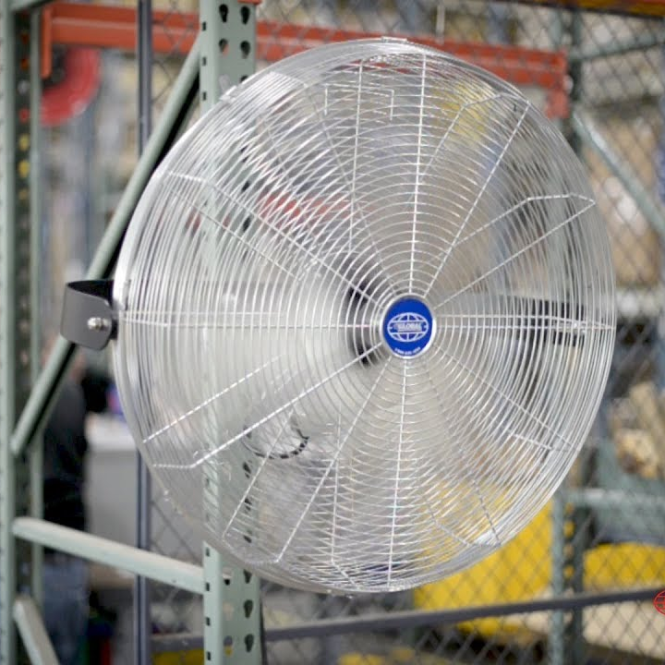
Nine types of energy waste (to spark observations)
Unnecessary running or idling
Leaks
Friction loss
Sub-optimal efficiency
Malfunctions
System imbalance
Misapplication
Underutilization
Traditional lean waste
Notes:
Unnecessary Running or Idling: Equipment, motors, or lighting left on during non-productive or inactive periods when they aren’t needed.
Leaks: Leaks in any system including compressed air, water, ducts, vacuums, steam.
Friction Loss: Anything impeding the delivery or removal of utilities or materials. Clogged filters, blocked inlets/outlets, dirty transfer surfaces (radiators or heat exchangers), motor belts, conveyance systems.
Sub-optimal Efficiency: When more efficient equipment or methods could be used. Could include old equipment, running inefficient equipment instead of the more efficient one (when there’s redundancy), or running in sub-optimal condition.
Malfunctions: Equipment with excess vibration, heat, or noise generation, broken or uncalibrated sensors, malfunctioning valves, switches, or dampers.
System Imbalance: When requirements are out of balance with capabilities or operations. System running full out instead of meeting demand, improper set points, competing efforts (simultaneous heating and cooling).
Misapplication: Using an energy-intensive system when a more efficient option is available. Improperly size equipment, compressed air used for open blowing, cooling, vacuum generation, pumps, hand tools.
Underutilization: Does scheduling of work prevent systems from operating at peak capacity or efficiency?
Traditional Lean Waste: Scrap, over-processing, excessive material handling, defects.

Slide 7
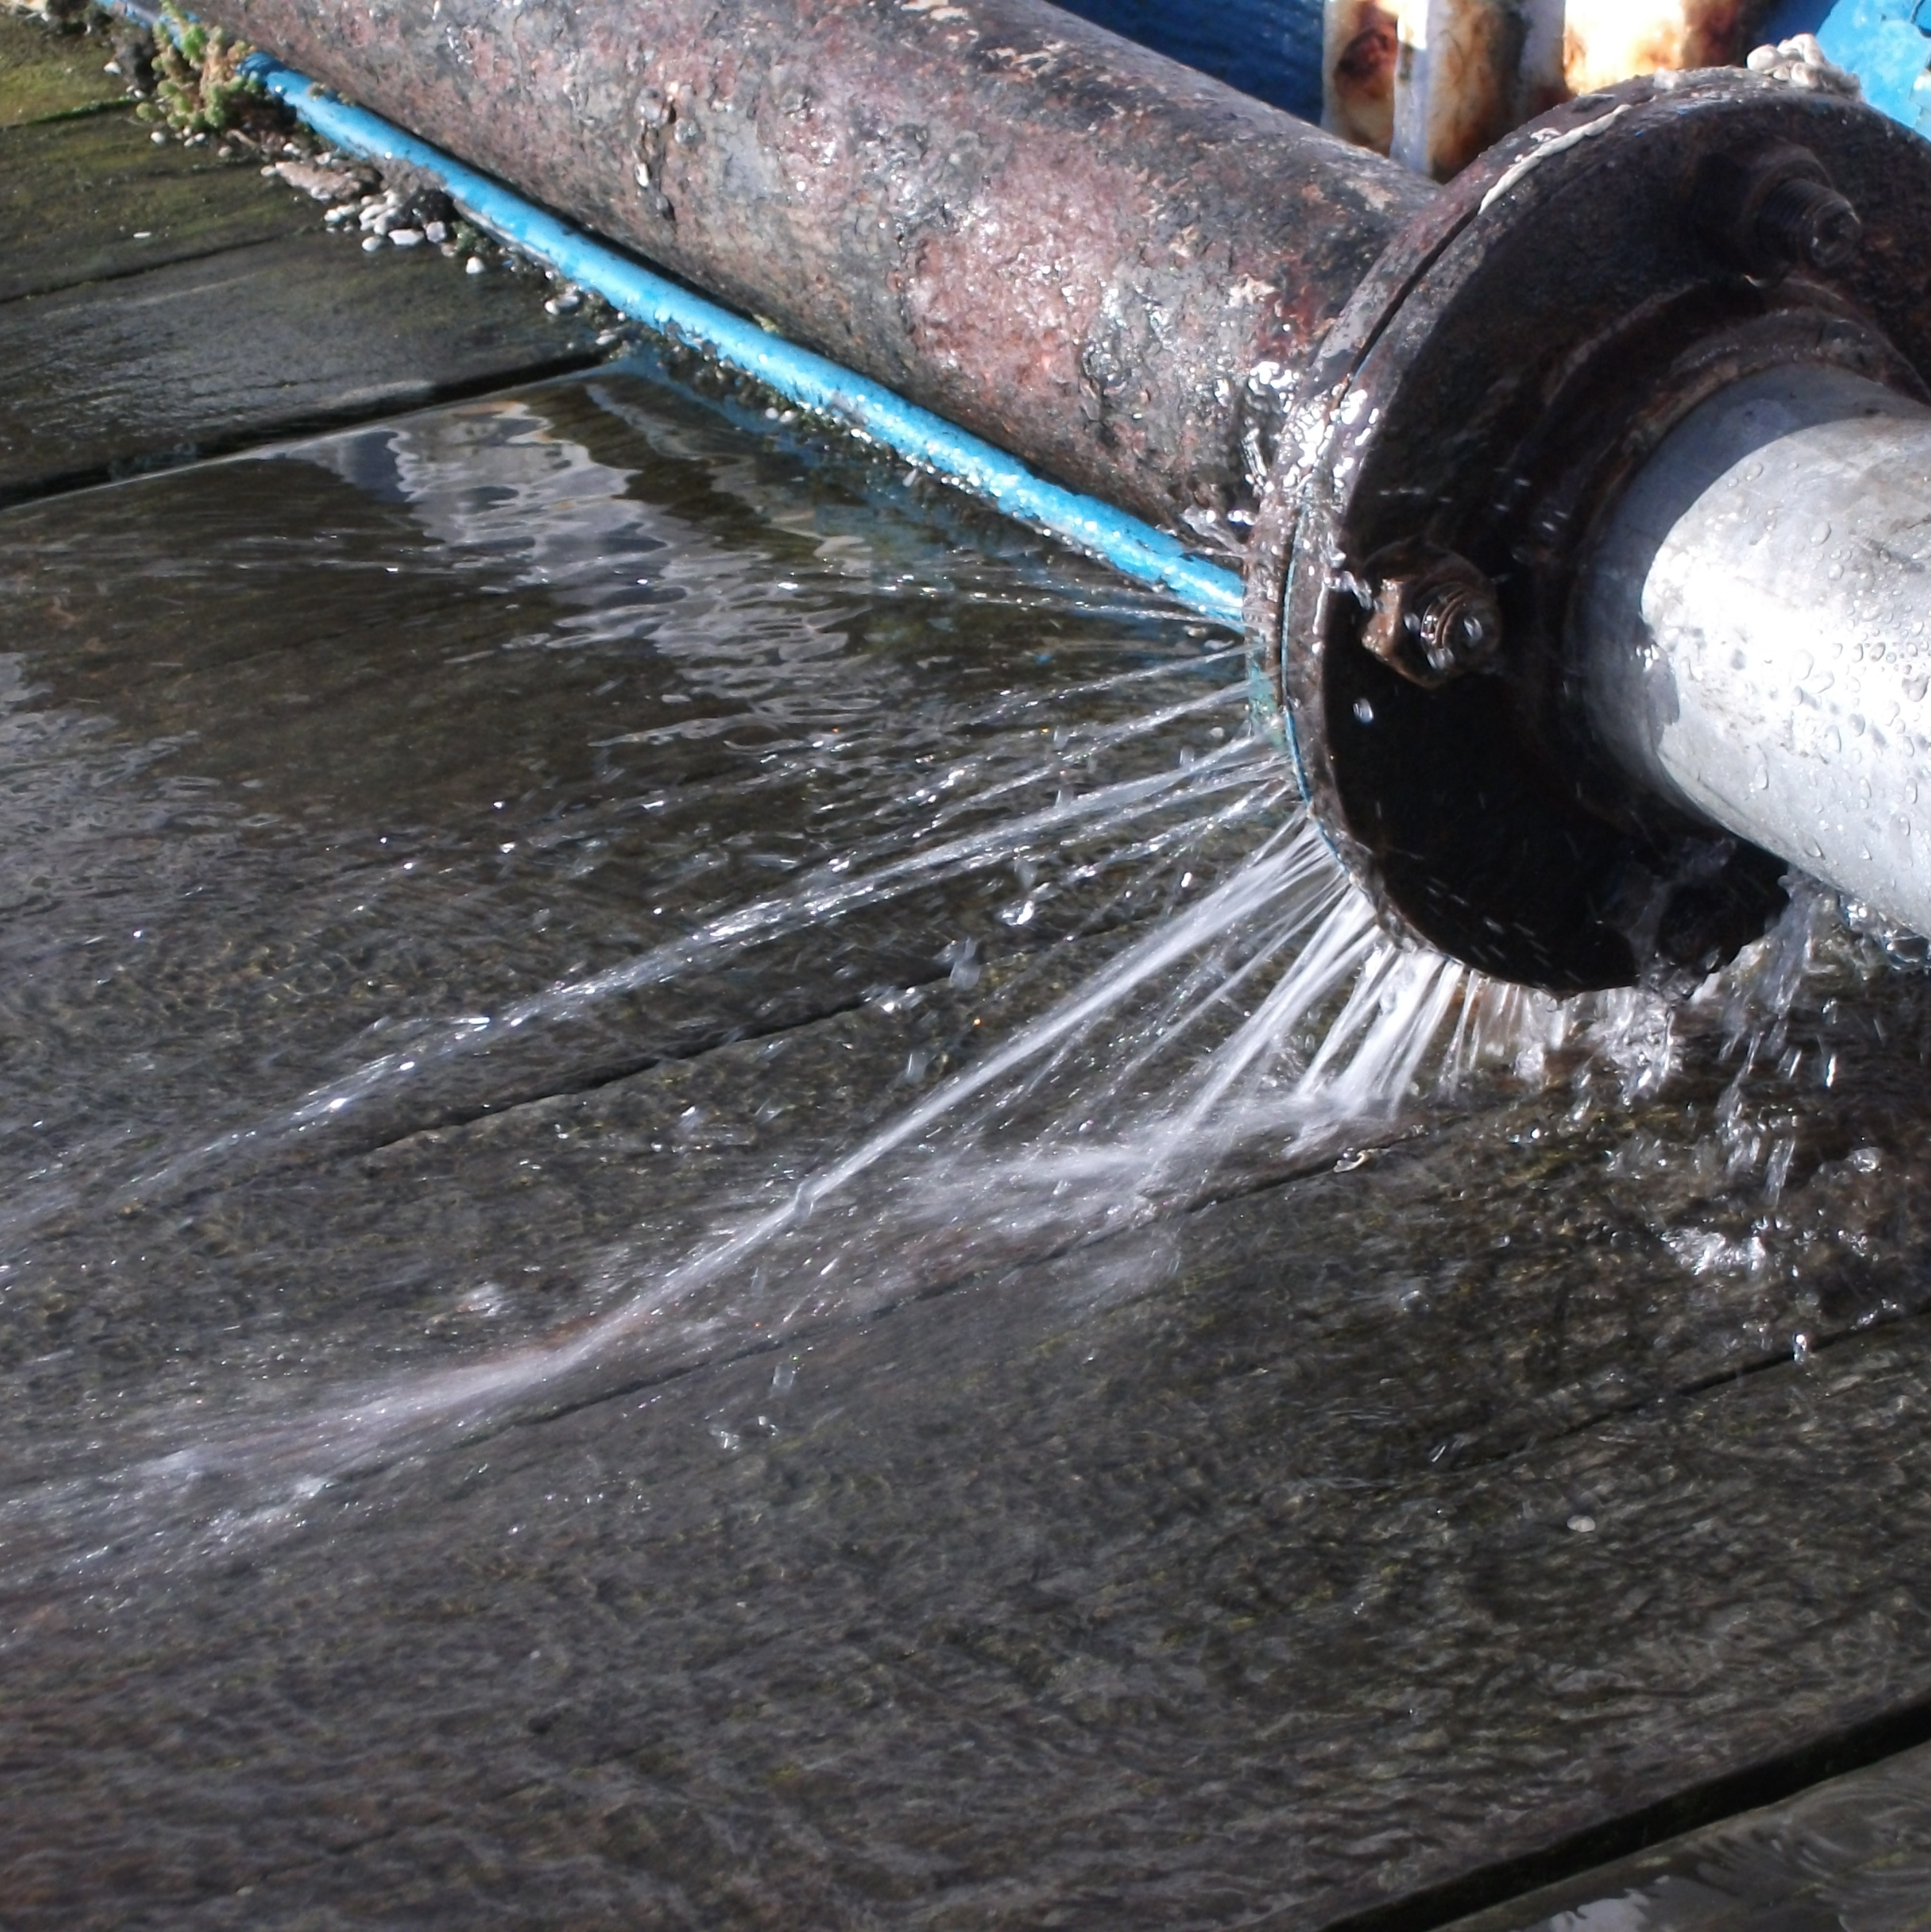
Nine types of energy waste (to spark observations)
Unnecessary running or idling
Leaks
Friction loss
Sub-optimal efficiency
Malfunctions
System imbalance
Misapplication
Underutilization
Traditional lean waste
Notes:
Unnecessary Running or Idling: Equipment, motors, or lighting left on during non-productive or inactive periods when they aren’t needed.
Leaks: Leaks in any system including compressed air, water, ducts, vacuums, steam.
Friction Loss: Anything impeding the delivery or removal of utilities or materials. Clogged filters, blocked inlets/outlets, dirty transfer surfaces (radiators or heat exchangers), motor belts, conveyance systems.
Sub-optimal Efficiency: When more efficient equipment or methods could be used. Could include old equipment, running inefficient equipment instead of the more efficient one (when there’s redundancy), or running in sub-optimal condition.
Malfunctions: Equipment with excess vibration, heat, or noise generation, broken or uncalibrated sensors, malfunctioning valves, switches, or dampers.
System Imbalance: When requirements are out of balance with capabilities or operations. System running full out instead of meeting demand, improper set points, competing efforts (simultaneous heating and cooling).
Misapplication: Using an energy-intensive system when a more efficient option is available. Improperly size equipment, compressed air used for open blowing, cooling, vacuum generation, pumps, hand tools.
Underutilization: Does scheduling of work prevent systems from operating at peak capacity or efficiency?
Traditional Lean Waste: Scrap, over-processing, excessive material handling, defects.

Slide 8
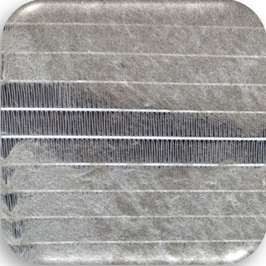
Nine types of energy waste (to spark observations)
Unnecessary running or idling
Leaks
Friction loss
Sub-optimal efficiency
Malfunctions
System imbalance
Misapplication
Underutilization
Traditional lean waste
Notes:
Unnecessary Running or Idling: Equipment, motors, or lighting left on during non-productive or inactive periods when they aren’t needed.
Leaks: Leaks in any system including compressed air, water, ducts, vacuums, steam.
Friction Loss: Anything impeding the delivery or removal of utilities or materials. Clogged filters, blocked inlets/outlets, dirty transfer surfaces (radiators or heat exchangers), motor belts, conveyance systems.
Sub-optimal Efficiency: When more efficient equipment or methods could be used. Could include old equipment, running inefficient equipment instead of the more efficient one (when there’s redundancy), or running in sub-optimal condition.
Malfunctions: Equipment with excess vibration, heat, or noise generation, broken or uncalibrated sensors, malfunctioning valves, switches, or dampers.
System Imbalance: When requirements are out of balance with capabilities or operations. System running full out instead of meeting demand, improper set points, competing efforts (simultaneous heating and cooling).
Misapplication: Using an energy-intensive system when a more efficient option is available. Improperly size equipment, compressed air used for open blowing, cooling, vacuum generation, pumps, hand tools.
Underutilization: Does scheduling of work prevent systems from operating at peak capacity or efficiency?
Traditional Lean Waste: Scrap, over-processing, excessive material handling, defects.

Slide 9
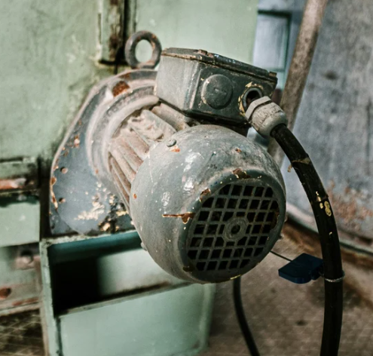
Nine types of energy waste (to spark observations)
Unnecessary running or idling
Leaks
Friction loss
Sub-optimal efficiency
Malfunctions
System imbalance
Misapplication
Underutilization
Traditional lean waste
Notes:
Unnecessary Running or Idling: Equipment, motors, or lighting left on during non-productive or inactive periods when they aren’t needed.
Leaks: Leaks in any system including compressed air, water, ducts, vacuums, steam.
Friction Loss: Anything impeding the delivery or removal of utilities or materials. Clogged filters, blocked inlets/outlets, dirty transfer surfaces (radiators or heat exchangers), motor belts, conveyance systems.
Sub-optimal Efficiency: When more efficient equipment or methods could be used. Could include old equipment, running inefficient equipment instead of the more efficient one (when there’s redundancy), or running in sub-optimal condition.
Malfunctions: Equipment with excess vibration, heat, or noise generation, broken or uncalibrated sensors, malfunctioning valves, switches, or dampers.
System Imbalance: When requirements are out of balance with capabilities or operations. System running full out instead of meeting demand, improper set points, competing efforts (simultaneous heating and cooling).
Misapplication: Using an energy-intensive system when a more efficient option is available. Improperly size equipment, compressed air used for open blowing, cooling, vacuum generation, pumps, hand tools.
Underutilization: Does scheduling of work prevent systems from operating at peak capacity or efficiency?
Traditional Lean Waste: Scrap, over-processing, excessive material handling, defects.

Slide 10
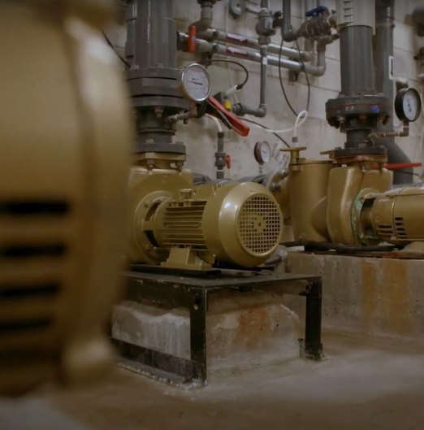
Nine types of energy waste (to spark observations)
Unnecessary running or idling
Leaks
Friction loss
Sub-optimal efficiency
Malfunctions
System imbalance
Misapplication
Underutilization
Traditional lean waste
Notes:
Unnecessary Running or Idling: Equipment, motors, or lighting left on during non-productive or inactive periods when they aren’t needed.
Leaks: Leaks in any system including compressed air, water, ducts, vacuums, steam.
Friction Loss: Anything impeding the delivery or removal of utilities or materials. Clogged filters, blocked inlets/outlets, dirty transfer surfaces (radiators or heat exchangers), motor belts, conveyance systems.
Sub-optimal Efficiency: When more efficient equipment or methods could be used. Could include old equipment, running inefficient equipment instead of the more efficient one (when there’s redundancy), or running in sub-optimal condition.
Malfunctions: Equipment with excess vibration, heat, or noise generation, broken or uncalibrated sensors, malfunctioning valves, switches, or dampers.
System Imbalance: When requirements are out of balance with capabilities or operations. System running full out instead of meeting demand, improper set points, competing efforts (simultaneous heating and cooling).
Misapplication: Using an energy-intensive system when a more efficient option is available. Improperly size equipment, compressed air used for open blowing, cooling, vacuum generation, pumps, hand tools.
Underutilization: Does scheduling of work prevent systems from operating at peak capacity or efficiency?
Traditional Lean Waste: Scrap, over-processing, excessive material handling, defects.

Slide 11
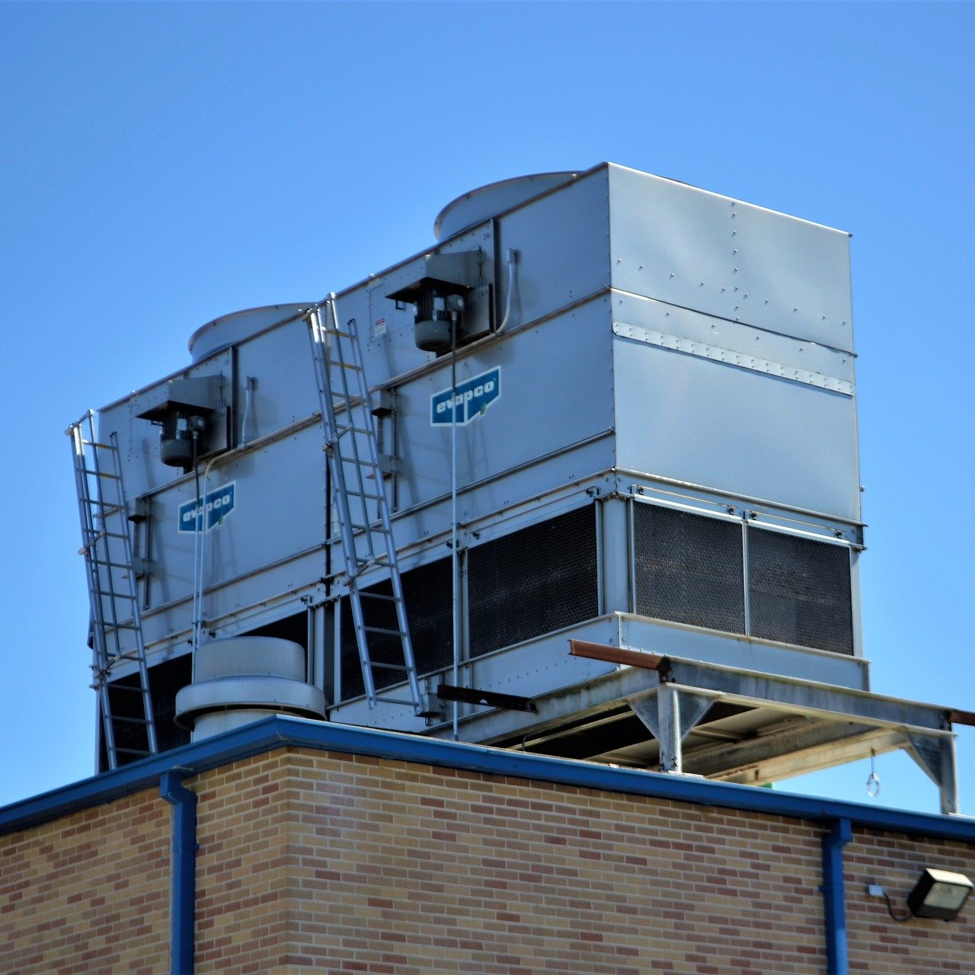
Nine types of energy waste (to spark observations)
Unnecessary running or idling
Leaks
Friction loss
Sub-optimal efficiency
Malfunctions
System imbalance
Misapplication
Underutilization
Traditional lean waste
Notes:
Unnecessary Running or Idling: Equipment, motors, or lighting left on during non-productive or inactive periods when they aren’t needed.
Leaks: Leaks in any system including compressed air, water, ducts, vacuums, steam.
Friction Loss: Anything impeding the delivery or removal of utilities or materials. Clogged filters, blocked inlets/outlets, dirty transfer surfaces (radiators or heat exchangers), motor belts, conveyance systems.
Sub-optimal Efficiency: When more efficient equipment or methods could be used. Could include old equipment, running inefficient equipment instead of the more efficient one (when there’s redundancy), or running in sub-optimal condition.
Malfunctions: Equipment with excess vibration, heat, or noise generation, broken or uncalibrated sensors, malfunctioning valves, switches, or dampers.
System Imbalance: When requirements are out of balance with capabilities or operations. System running full out instead of meeting demand, improper set points, competing efforts (simultaneous heating and cooling).
Misapplication: Using an energy-intensive system when a more efficient option is available. Improperly size equipment, compressed air used for open blowing, cooling, vacuum generation, pumps, hand tools.
Underutilization: Does scheduling of work prevent systems from operating at peak capacity or efficiency?
Traditional Lean Waste: Scrap, over-processing, excessive material handling, defects.

Slide 12
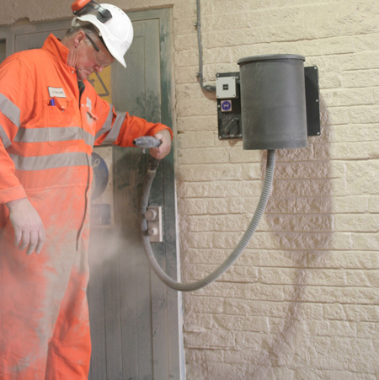
Nine types of energy waste (to spark observations)
Unnecessary running or idling
Leaks
Friction loss
Sub-optimal efficiency
Malfunctions
System imbalance
Misapplication
Underutilization
Traditional lean waste
Notes:
Unnecessary Running or Idling: Equipment, motors, or lighting left on during non-productive or inactive periods when they aren’t needed.
Leaks: Leaks in any system including compressed air, water, ducts, vacuums, steam.
Friction Loss: Anything impeding the delivery or removal of utilities or materials. Clogged filters, blocked inlets/outlets, dirty transfer surfaces (radiators or heat exchangers), motor belts, conveyance systems.
Sub-optimal Efficiency: When more efficient equipment or methods could be used. Could include old equipment, running inefficient equipment instead of the more efficient one (when there’s redundancy), or running in sub-optimal condition.
Malfunctions: Equipment with excess vibration, heat, or noise generation, broken or uncalibrated sensors, malfunctioning valves, switches, or dampers.
System Imbalance: When requirements are out of balance with capabilities or operations. System running full out instead of meeting demand, improper set points, competing efforts (simultaneous heating and cooling).
Misapplication: Using an energy-intensive system when a more efficient option is available. Improperly size equipment, compressed air used for open blowing, cooling, vacuum generation, pumps, hand tools.
Underutilization: Does scheduling of work prevent systems from operating at peak capacity or efficiency?
Traditional Lean Waste: Scrap, over-processing, excessive material handling, defects.

Slide 13
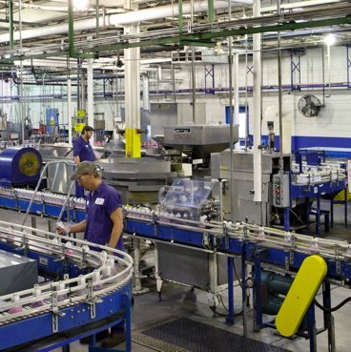
Nine types of energy waste (to spark observations)
Unnecessary running or idling
Leaks
Friction loss
Sub-optimal efficiency
Malfunctions
System imbalance
Misapplication
Underutilization
Traditional lean waste
Notes:
Unnecessary Running or Idling: Equipment, motors, or lighting left on during non-productive or inactive periods when they aren’t needed.
Leaks: Leaks in any system including compressed air, water, ducts, vacuums, steam.
Friction Loss: Anything impeding the delivery or removal of utilities or materials. Clogged filters, blocked inlets/outlets, dirty transfer surfaces (radiators or heat exchangers), motor belts, conveyance systems.
Sub-optimal Efficiency: When more efficient equipment or methods could be used. Could include old equipment, running inefficient equipment instead of the more efficient one (when there’s redundancy), or running in sub-optimal condition.
Malfunctions: Equipment with excess vibration, heat, or noise generation, broken or uncalibrated sensors, malfunctioning valves, switches, or dampers.
System Imbalance: When requirements are out of balance with capabilities or operations. System running full out instead of meeting demand, improper set points, competing efforts (simultaneous heating and cooling).
Misapplication: Using an energy-intensive system when a more efficient option is available. Improperly size equipment, compressed air used for open blowing, cooling, vacuum generation, pumps, hand tools.
Underutilization: Does scheduling of work prevent systems from operating at peak capacity or efficiency?
Traditional Lean Waste: Scrap, over-processing, excessive material handling, defects.

Slide 14
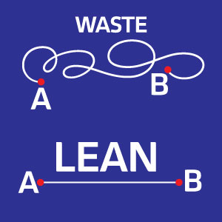
Nine types of energy waste (to spark observations)
Unnecessary running or idling
Leaks
Friction loss
Sub-optimal efficiency
Malfunctions
System imbalance
Misapplication
Underutilization
Traditional lean waste
Notes:
Unnecessary Running or Idling: Equipment, motors, or lighting left on during non-productive or inactive periods when they aren’t needed.
Leaks: Leaks in any system including compressed air, water, ducts, vacuums, steam.
Friction Loss: Anything impeding the delivery or removal of utilities or materials. Clogged filters, blocked inlets/outlets, dirty transfer surfaces (radiators or heat exchangers), motor belts, conveyance systems.
Sub-optimal Efficiency: When more efficient equipment or methods could be used. Could include old equipment, running inefficient equipment instead of the more efficient one (when there’s redundancy), or running in sub-optimal condition.
Malfunctions: Equipment with excess vibration, heat, or noise generation, broken or uncalibrated sensors, malfunctioning valves, switches, or dampers.
System Imbalance: When requirements are out of balance with capabilities or operations. System running full out instead of meeting demand, improper set points, competing efforts (simultaneous heating and cooling).
Misapplication: Using an energy-intensive system when a more efficient option is available. Improperly size equipment, compressed air used for open blowing, cooling, vacuum generation, pumps, hand tools.
Underutilization: Does scheduling of work prevent systems from operating at peak capacity or efficiency?
Traditional Lean Waste: Scrap, over-processing, excessive material handling, defects.

Slide 15
Tips for the walkthrough
Enter workstations cautiously, show respect for workers and let them lead the way
Uncover possible root causes by using the “5 whys” technique
Ask permission before taking photos during the walkthrough
Observe general patterns and specific equipment behaviours
Record each opportunity on the tracking sheet, including equipment details such as horsepower, wattage, run-times, set points, schedules or override conditions
Ask questions about standard procedures and about anything that seems unusual or out of the ordinary
Flag any missing or unclear data for follow-up
Thank staff who took time to answer questions or provide insight

Slide 16



How to spot energy waste safely
Look
Listen
Feel (carefully)
Equipment left running
Malfunctioning controls
Clogged filters
Condensation on pipes
Noisy equipment
Compressed air leaks
Employee complaints
Excessive heat or cold
Drafts – heating or cooling loss
Vibration

Slide 17

Safety reminders
Wear required personal protective equipment (PPE) at all times
Stay in designated walkways
Do not write notes while walking
Do not touch equipment unless authorized
Follow all site instructions

Slide 18
Example questions to ask
What time does the equipment need to be started to meet production?
What are the minimum/maximum setpoint requirements of the system or equipment?
What equipment can be turned off at breaks, lunch or between shifts?
What time can the equipment be turned off after production?
Can wasted energy be recovered or reused?
What is the overall system requirement?
Have there been any complaints about the equipment or facility conditions?

Slide 19
What makes a good observation?
Be specific: What’s happening? Where? When?
Describe what was seen, heard or felt (if safe)
Include location, equipment, timing and any clues (like sound or heat)
Mention if it is usual or unusual operation
Flag anything that needs follow-up
Use plain language — no need to analyze or propose a full solution

Slide 20
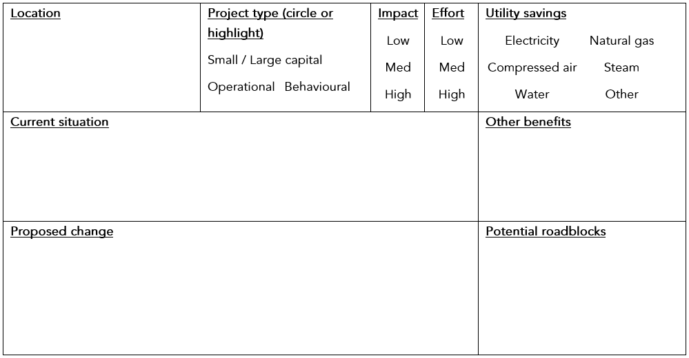
Example: a clear tracking sheet entry
Compressor room 2
Air compressor runs continuously overnight even when no production is happening. Hissing noise near the valve. Gauges indicate no pressure drop.
Reduced noise for staff. Less wear on equipment.
Need approval from maintenance supervisor to test shutdown during off-hours.
Investigate valve for leak. Install automatic shutoff or schedule downtime.
Notes:
Suggested talking points for this slides: “Here’s what a clear observation looks like in the tracking sheet.”
“You can jot your notes as you go, and we’ll clean them up if needed after.”
“Just do your best — this is about spotting opportunities, not writing perfect reports.”

Slide 21



Eliminating energy waste
Identify quick wins (low cost/effort)
Implement processes or controls
Investigate higher-effort opportunities
Notes:
You may be wondering what will happen once you’ve identified where energy waste is occurring.
We’ll have a debrief session to review and prioritize opportunities and determine next steps.

Slide 22
Next steps
Conduct our energy hunt walkthrough
Use the opportunity tracking sheet
Send your opportunities to the energy champion (me)
Join the energy hunt debrief session

Slide 23



Thank you
SaveOnEnergy.ca
@SaveOnEnergyOnt
saveonenergy@ieso.ca
facebook.com/SaveOnEnergyOntario
linkedin.com/showcase/SaveOnEnergy-Ontario

